Slide 1
Acknowledging Messages
October 2, 2013
Notes:
Guidewire training materials contain Guidewire proprietary information that is subject to confidentiality and non-disclosure agreements. You agree to use the information in this manual solely for the purpose of training to implement Guidewire software solutions. You also agree not to disclose the information in this manual to third parties or copy this manual without prior written consent from Guidewire. Guidewire training may be given only by Guidewire employees or certified Guidewire partners under the appropriate agreement with Guidewire.

Slide 2
Describe the different types of acknowledgements
Acknowledge messages as successful, retryable errors, and non-retryable errors
Acknowledge messages synchronously
Acknowledge messages asynchronously
Use the administration screens to view a message's status and manipulate it manually as needed

Slide 3
Overview of message acknowledgements
Working with acknowledgements
Synchronous acknowledgement
Asynchronous remote call acknowledgement
Reply plugin acknowledgement
Message administration

Slide 4

Message acknowledgement
Send message
Guidewire application
Response sent
External system
interpret response
Message acknowledgement is the process in which Guidewire interprets that response
Expected behavior is that every sent message will receive a response
Notes:
Guidewire expects that every sent message will immediately or eventually be followed by a response from the external system
There is the possibility that the external system never sends a response for a given message. This is also discussed later in this lesson.

Slide 5
Interpreting the external system response
positive ACK
retryable error
Guidewire application
External system
non-retryable error
duplicate response
(no response)
Guidewire interprets four response types
No response also requires handling
Notes:
Guidewire can interpret a response to be one of four types: positive acknowledgement, retryable error, non-retryable error, an duplicate response. Guidewire must also react when the external system never sends a response to a message
NOTE: non-retryable error is a deprecated response in Guidewire 8.

Slide 6
Message and MessageHistory
Message table contains
Messages that have yet to be sent
Messages that require manual intervention
Sent messages pending acknowledgement
Sent messages waiting to be retried
MessageHistory table contains
Positively acknowledged messages
Skipped messages
xx_message
ACK'd
skipped
xx_message history
Notes:
A message can move from the message table to the message history table if the message is positively acknowledged or skipped. The Message table contains messages that need further processing. The MessageHistory table contains messages that do not need further processing. A message can move from the message table to the message history table if the message is positively acknowledged or skipped. Otherwise, the message remains in the message table.
Over time, the message history table accumulates a large number of message histories and therefore needs to be pruned on a regular basis. The MessageToolsAPI has a purgeCompletedMessages() method that can be used to do this. For more information on pruning the MessageHistory table, refer to the System Administration Guide.

Slide 7
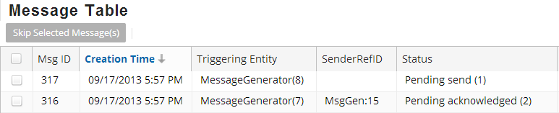
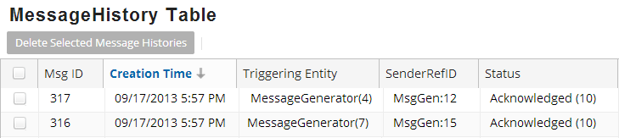
Positive acknowledgements
When the external system reports a message was successfully received and processed, Guidewire interprets this as a positive acknowledgement (ACK)
Guidewire application response to ACK
Moves the message from Message to MessageHistory
Changes the status to reflect acknowledgement
Notes:
When the external system reports a message was successfully received and processed, Guidewire interprets this as a positive acknowledgement, also known as an ACK. When a message is positively acknowledged, Guidewire a) moves the message from Message to MessageHistory, and b) changes the status to reflect acknowledgement.
Status is an integer field on both Message and MessageHistory. In most cases, developers do not need to know what each integer represents. However, the statuses are defined in the Data Dictionary. The "Status" column in the TrainingApp Message Table and MessageHistory Table screens includes both the integer code and its meaning. (For example, a Status of "2" means "pending acknowledged".)

Slide 8
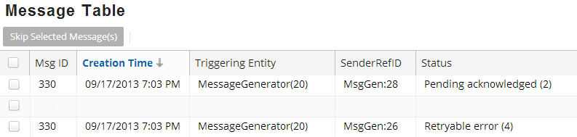
Retryable errors
Retryable error
Sent message successfully received by the external system
External system cannot process the message
Processing issue is temporary
External systems sends negative acknowledgement (NACK)
Guidewire application response
Keeps the message in the Message table
Status reflects the retryable error
Typically waits and then sends a copy of the message
Notes:
A retryable error indicates a condition that is expected to be temporary. For example, the external system might be unreachable due to network problems, the file system is full, a database lock exists and has not been released, or the external system simply reports a temporary error.
A message can become "retryable" during the sending to the external system. This occurs when an exception is thrown in the Request plugin's beforeSend() method or the Transport plugin's send() method. Guidewire automatically attempts to retry the message until the maximum number of retries has been reached, as specified by the destination's Max Retries. When a message has been retried unsuccessfully the maximum number of times, the destination is suspended. (This is discussed in further detail in the "Sending Messages" lesson.)
The term "negative acknowledgement" (or "nack") is used for both retryable and non-retryable errors. It indicates that the external system did acknowledge the message, but in a negative way.
If a message is safe ordered, the next message for the destination/entity pair will not be sent until the message is either resent and successfully acknowledged or skipped.

Slide 9
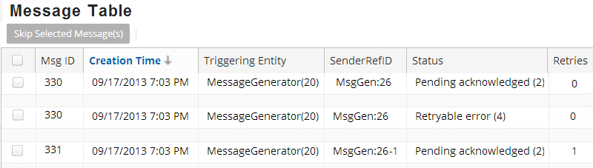
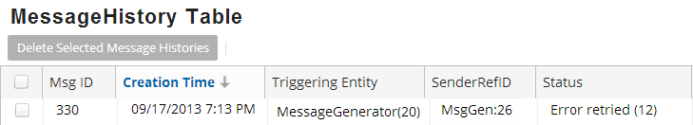
Retrying a retryable error message
Message is moved to MessageHistory
A copy of the message is created and sent
References the same event and triggering entity
Uses a different SenderRefID
Incremented retry field by 1
Notes:
Note that in the screenshot of the Message table, there are two messages, one with an ID of 330 and one with an ID of 331. The first message had a status of "Pending acknowledged" and then had a status of "Retryable error". When the error was retried, Message 330 was moved to the MessageHistory table, and Message 331 was created and sent. Even though Message 331 has a different SenderRefID, it is linked to the same triggering entity (MessageGenerator(20)). So Message 330 and Message 331 are two separate message instances that relate to the same logical business event.

Slide 10
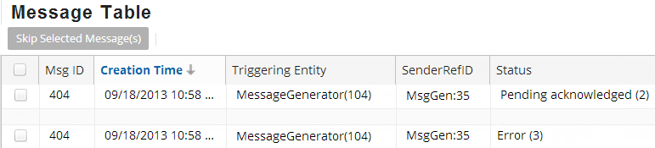
Non-retryable errors
Non-retryable error cannot be retired
Sent message successfully received by the external system
External system cannot process the message
Processing issue is permanent
External systems sends negative acknowledgement (NACK)
Guidewire application response
Status reflects the error
Keeps the message in the Message table until skipped
Notes:
If the message was not successfully processed, and the issue is expected to be permanent, Guidewire reports this as a non-retryable error which is also referred to as a negative acknowledgement (NACK).
The term "negative acknowledgement" (or "nack") is used for both retryable and non-retryable errors. It indicates that the external system did acknowledge the message, but in a negative way. The message remains in the Message table until it is skipped. Very few messages should be flagged as non-retryable.
A non-retryable message cannot be retried. Non-retryable errors are designed for cases where the message's payload is invalid and for some reason the validation rules and logic could not detect an issue prior to message being sent. A non-retryable error should result only from circumstances where the needs of the external system have changed in a way that the Guidewire application could not have anticipated. For example, the message is sent using a web service, but the user account used to call the web service no longer exists or can no longer be authenticated. Consequently, a message should be reported as non-retryable only if there will not be an attempt to send the message again. If there is a chance that the condition causing the error is temporary in nature, then the message should be reported as retryable.
An administrator can manually skip a message or code can skip a message, for example, from within a batch process.

Slide 11
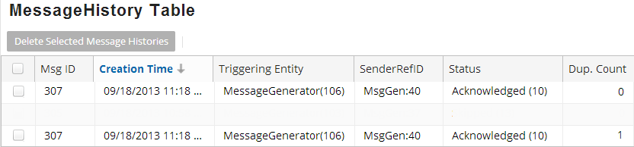
Duplicate messages
Duplicate messages
One sent message successfully received by the external system
External system processes the same message more than once
External systems sends a positive acknowledgement (ACK) per each processed duplicate
Guidewire application response
Increments the Duplicate Count (Dup. Count) in the Message History table
Notes:
Guidewire does not treat a message with a non-zero duplicate count any differently from a message with a zero-duplicate count. However, the recommendation is to process duplicates reported by the external system so as to retain as much information as possible about what was sent from the external system.

Slide 12
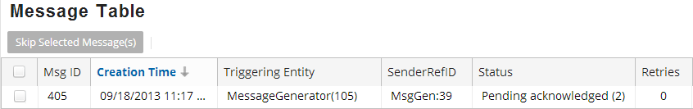
No response
Guidewire application sends message to external system
No ACK or NACK from external system
Guidewire application response
Keeps the message in the Message table
Consider batch process to purge message table
Apply logic for overdue messages
Notes:
If no reply is received for a message, the message remains in the Message table. There is no time frame at which the message is automatically resent or abandoned. Typically, a custom batch process or third-party database tool checks the Message table for messages whose responses are overdue and then takes appropriate steps to fix the situation.
The Message table should be checked for messages that have not received a reply within a timely fashion. This could be a Guidewire custom batch process or a database tool that monitors the Message table. Each non-response message typically requires manual evaluation to determine the cause of the non-response and the appropriate steps to fix the situation.

Slide 13

Acknowledgement strategies
Messaging destinations require acknowledgement strategies
Synchronous with the sending of message
Asynchronous via an API
Asynchronous via a listener or polling strategy
(synchronous)
API
listener / polling
Notes:
Typically, each destination expects to receive acknowledgements in one of three ways: synchronous with the sending of message, asynchronous from an API, or asynchronous with a listener or polling mechanism

Slide 14
Plugins that acknowledge messages
Request Plugin
external system
xx_message
sending message
Transport Plugin
synchronous reply
(no plugin)
asynchronous reply via API
asynchronous reply via listener or polling
Reply Plugin
Notes:
Every destination has up to three plugins that are used for messaging. Two of these plugins could play a role in acknowledging a message, though it is possible that no plugin is used for acknowledgement.
The request plugin is an optional plugin that is responsible for payload transformation. It is not involved in the acknowledgement of messages.
The transport plugin is a required plugin that is responsible for sending the message to the external system. If the acknowledgement is received synchronously, then this plugin also processes the reply.
An external system can acknowledge a message using a remote call (either the IMessageToolsAPI or a custom-built web service). If a remote call is used, then the message reply is handled independent of the destination's plugins.
The reply plugin is an optional plugin that initializes a listener queue and associates it to the destination. It processes acknowledgements sent asynchronously using the listener queue.
Like predefined plugins, messaging plugins can be implemented in Gosu or Java.

Slide 15

Message acknowledgement transactions
Application server(s)
Batch server
triggering and payload generation
sending to external system
xx_message
payload
tran 1
tran 2
tran 3
tran 4
processing acknowledgement
external system
Synchronously acknowledged message
Acknowledgement processed in the sending transaction
Asynchronously acknowledged message:
Acknowledgement processed in separate transaction
Notes:
If a message is acknowledged synchronously, the acknowledgement is processed in the same transaction that sends the message.
If a message is acknowledged asynchronously, the acknowledgement is processed in its own transaction.

Slide 16
Overview of message acknowledgements
Working with acknowledgements
Synchronous acknowledgement
Asynchronous remote call acknowledgement
Reply plugin acknowledgement
Message administration

Slide 17
Reporting positive acknowledgement
36 // message was successfully processed 37 aMessage.reportAck() 38 // make additional changes to triggering entity 39 var relatedContact = aMessage.MessageRoot as ABContact …41 relatedContact.LegalCaseReportStatus =
42 LegalCaseReportStatus.TC_REQUESTED_RECEIVED 43 relatedContact.LastLegalCaseReportDate = 44 DateUtil.currentDate()
message.reportAck()
Include processes that respond to the acknowledgement:
Changing a verified status to true
Recording an acknowledgement code
Saving a received report to the database
Notes:
In some cases, messaging is used to request reports from external systems, such as:
A police report detailing an accident or burglary of insured items.
A medical report detailing customary prices for given medical procedures.
A fraud report detailing that a claim for a given loss has already been filed.
In these cases, the external system responds with the report. The messaging code must both report positive acknowledgement of the message and save the report to the Guidewire database.

Slide 18
Reporting retryable errors (below max)
Message destination should define retry behavior
Max retries after initial send
Initial retry interval
Retry backoff multiplier
Define parameters for maximum retries
Plugin parameter (for reply code in transport/reply plugin)
Script parameter (for reply code in web services)
message.reportError(retryTime)
Call before the max retries has reached
Guidewire send again at the retry time
Use a new SenderRefID
Increase the resend time per each resend
Notes:
Every destination should have a specific number of times a message can be retried after the initial send. The number of retries should be specified using either a plugin parameter for the reply code in the transport or reply plugin or a script parameter for the reply code in the web services handler.
Before the max has been reached, report the error using message.reportError(whenToResendMessage). Then, when sending the retry message, use a new SenderRefID even though it pertains to the same message event, it must be treated as a new message. The amount of time between resends should increase with each resend.
If a message is resent two or more times because the external system reported a retryable error, each message should use a different SenderRefID. This is because the external system may treat two messages with the same ID as the same message. (In other words, the external system may be "duplicate aware".) If the second message uses the same SenderRefID as the first, then the external system may ignore it or report it as a duplicate, which would prevent the message from ever getting processed.
You can also manually retry any message using the Event Messages administration screens. This is discussed later in this lesson.

Slide 19
Retry time for retryable errors example
12 static function reportRetryableError(aMessage: Message, errorCategory: ErrorCategory): String {
…18 var maxRetries = ScriptParameters.MaxRetriesForRetryableMessage
19 if (aMessage.RetryCount < maxRetries) { 20 var backOffMultiplier = aMessage.RetryCount + 1 21 var waitTime: int = backOffMultiplier * 60 22 // wait time in seconds
23 var retryTime = DateUtil.addSeconds(DateUtil.currentDate(),
waitTime)
24 // report the message error with retryTime
25 aMessage.reportError(retryTime)
26 return ("Error reported for message " + aMessage.SenderRefID + "; retry #" + (aMessage.RetryCount + 1)
+ " set for " + retryTime.formatDateTime(SHORT, SHORT))
…33 }
34 }
A message's RetryCount property
Starts at 0 and incremented after each reportError() resend
Notes:
The code shown above can be found in TrainingApp in the trainingapp.demo.messageack.MessageAckUtil class.
A backoff multiplier is a value that is used to increase a retry interval arithmetically. In the example above, the backoff multiplier simply increases the wait time by 60 seconds per iteration. For the first resend, aMessage.RetryCount is 0, so backOffMultiplier is set to 1 and waitTime is set to 60 seconds. For the second resend, aMessage.RetryCount is 1, so backOffMultiplier is set to 2 and waitTime is set to 120 seconds. For the third resend, waitTime is set to 180 seconds, and so on.

Slide 20
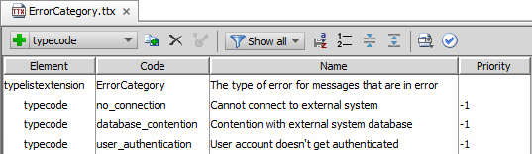
Reporting retryable errors (at max retries)
Define typekeys in ErrorCategory typelist extension
…\config\extensions\typelist\ErrorCategory.ttx
message.reportError(errorCategory)
Call when retry max has been reached
Specify the error category
Alert an administrator to the message error
Guidewire no longer tries to resend the message
Notes:
ErrorCategory is a typelist that identifies the error reason for a message. In each base application, the typelist is empty.
When a given message's retry max has been reached, report the error using essage.reportError(errorCategory). Alert an administrator to the issue as it pertains to the message error. Guidewire will no longer try to resend the message.

Slide 21
At max retryable errors example
12 static function reportRetryableError(aMessage: Message, errorCategory: ErrorCategory): String {
…19 if (aMessage.RetryCount < maxRetries) {
…27 } else {
…30 aMessage.reportError(errorCategory)
31 alertAdminAboutMessageError(aMessage, true)
32 return ("Error reported for message "
+ aMessage.SenderRefID
+ "; retry max reached)
33 }
34 }
message.reportError(errorCategory)
Call before the max retries has reached
The alert to the administrator usually takes the form of:
An email sent to the administrator, or
An activity assigned to the administrator
Notes:
The code shown in this section of the lesson can be found in TrainingApp in the trainingapp.demo.messageack.MessageAckUtil class. It is also possible to have a database tool monitor the Message table directly for at-max-retry messages.
The second parameter for the alertAdminAboutMessageError (isRetryableError) makes the message retryable if set to true.

Slide 22
Contrasting retry scenarios
 | Automatic retry during send | Automatic retry after send | Manual retry
What is the problem? | Exception thrown in beforeSend() or send() | External System reports retryable error | Message needs manual intervention
What executes the retry? | Internal Guidewire behavior | Integration code | Admin (using Retry button)
Should each attempt use the same SenderRefID | Yes | No | Yes
What specifies the max retry number? | Max Retries property for messaging destination | Integration code using parameter from plugin or script | n/a
What happens when the max number of retires is reached? | The destination is suspended | Integration code reports error with error category | n/a
Notes:
A message could be retried automatically during the sending of the message. A message could be retried manually. Both are discussed in detail in the Sending Messages lesson.
A message could be retried automatically after the sending of the message.
Occurs when the external system reports a retryable error. For example, the message was received but not successfully consumed. The error is expected to be temporary, such as unavailable network resource.
The message should be retried automatically by the integration code. When the code reports a retryable error, it should specify a retry time.
Even though it pertains to the same message event, the retry is a different message and the same SenderRefID should not be used. If the same SenderRefID is used, then the external system may consider the second attempt to be a duplicate message and disregard it.
The maximum number of retries is specified by the integration code as defined by plugin parameter (for the transport or reply plugin) or a script parameter.
If a given message exceeds the maximum number of retries, then the message should be reported with an appropriate error category, an administrator should be alerted somehow, and no further automatic attempts should be made. Any other messages for the same destination should not be affected.

Slide 23
Reporting non-retryable errors
53 static function reportNonRetryableError(aMessage: Message) : String {
…57 aMessage.reportNonRetryableError()
58 alertAdminAboutMessageError(aMessage, false)
59 return ("Non-retryable error reported for message "
+ aMessage.SenderRefID + ".")
60 }
message.reportNonRetryableError()
Prevents the message from any further retry
Use when data is invalid
Validation logic cannot prevent
Any additional retry will fail
Follow with an alert to the administrator
Notes:
The code shown in this section of the lesson can be found in TrainingApp in the trainingapp.demo.messageack.MessageAckUtil class.
The second parameter for the alertAdminAboutMessageError (isRetryableError) makes the message retryable if set to true. In this example, the parameter value is false. Any additional retries of this message will fail.
NOTE: reportNonRetryableError() is a deprecated method in Guidewire 8.0.

Slide 24
Reporting duplicates
65 static function reportDuplicate(senderRefID: String): String {
66 var aMessageHistory: MessageHistory = null
67 var resultString = ""
68 var queryObj = Query.make(MessageHistory)
69 queryObj.compare("SenderRefID", Equals, senderRefID)
…74 if (aMessageHistory == null) { …76 resultString = "There is no MessageHistory with the given ID in the MessageHistory table."
77 } else {
…79 Transaction.runWithNewBundle(\bundle -> {
80 aMessageHistory = bundle.add(aMessageHistory)
81 aMessageHistory.reportDuplicate()
…83 }, "su")
84 resultString = "There is no MessageHistory with the given ID in the MessageHistory table."
+ aMessage.SenderRefID + ".")
85 }
86 return resultString
87 }
From MessageHistory instances, report duplicates
Notes:
Duplicates can be reported only from MessageHistory instances. When an external system reports a duplicate, the integration code should simply find the related entry in the MessageHistory table (based on the message identifier, such as the SenderRefID) and report the duplicate. The only effect this has is incrementing the MessageHistory entry's DuplicateCount integer. Guidewire does not treat a message with a non-zero duplicate count any differently than a message with a zero-duplicate count. However, the recommendation is to process duplicates reported by the external system so as to retain as much information as possible about what was sent from the external system.

Slide 25
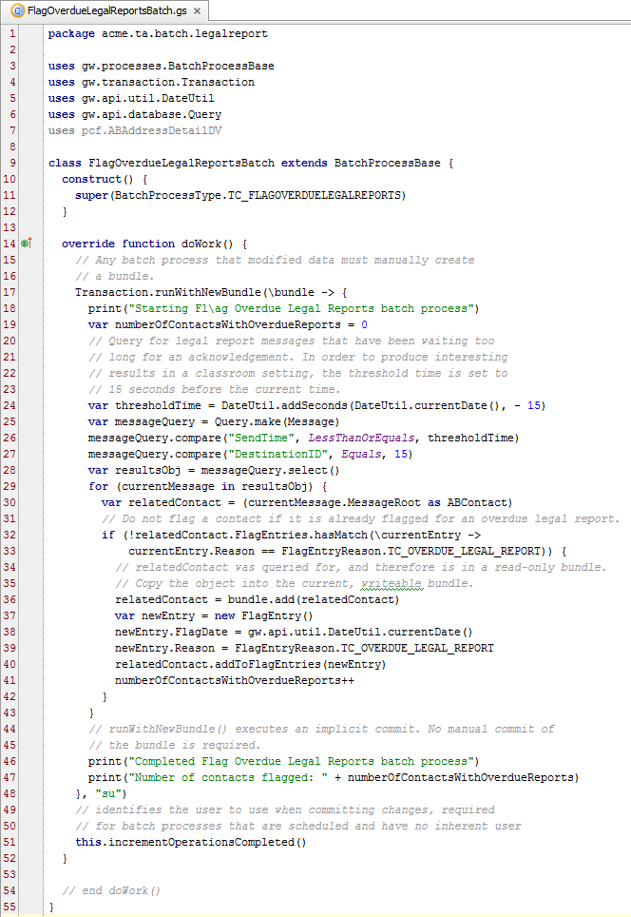
Messages without responses
Check for messages that have not received a reply within a timely fashion
Check the xx_message table
Batch process
Database monitoring tool
Evaluate the cause and handle the resolution
FlagOverdueLegalReportsBatch
Notes:
Periodically, the Message table should be checked for messages that have not received a reply within a timely fashion. This could be a Guidewire custom batch process or a database tool that monitors the Message table. Each message typically requires manual evaluation to determine the cause of the non-response and the appropriate steps to fix the situation.

Slide 26
Overview of message acknowledgements
Working with acknowledgements
Synchronous acknowledgement
Asynchronous remote call acknowledgement
Reply plugin acknowledgement
Message administration

Slide 27
Synchronous acknowledgement
In some cases, acknowledgement can be provided immediately after sending the message
In this case, acknowledgement code is included in the transport plugin's send() method
external system
xx_message
sending message
Transport Plugin
Synchronous reply
Notes:
Messages can be acknowledged in the send() method if successful delivery constitutes successful consumption, or if there is a return value from the external system that indicates success. For example, in a synchronous call, a certain return value could indicate acknowledgement.

Slide 28
Example: Synchronous acknowledgement
52 isVerified != requestVerificationFromExternal(payload)
53 if (isVerified != null) {
54 aMessage.reportAck()
55 print(" Acknowledged Message ID " + aMessage.ID + " synchronously")
56 if (isVerified) {
57 (aMessage.MessageRoot as BankAccount).IsVerified =
VerificationStatus.TC_VERIFIED
…59 } else {
60 (aMessage.MessageRoot as BankAccount).IsVerified =
VerificationStatus.TC_INVALID
…62 }
Verification is requested and if verification is not null
message.reportAck()
The bank account's IsVerified field is set based on the value returned from the external system (lines 56 - 60)

Slide 29
Overview of message acknowledgements
Working with acknowledgements
Synchronous acknowledgement
Asynchronous remote call acknowledgement
Reply plugin acknowledgement
Message administration

Slide 30
No plugin for asynchronous remote calls
Message acknowledged asynchronously through an API
Ack code is not executed from a plugin
xx_message
sending message
Transport Plugin
(no plugin)
asynchronous reply via API
Notes:
Messages can be acknowledged asynchronously through an API. In this case, the ACK code is not executed from a plugin. An external system can acknowledge a message using a remote call (either the MessageToolsAPI or a custom-built web service). If such a remote call is used, then the message reply is handled in code that is independent of the destination's plugins.

Slide 31
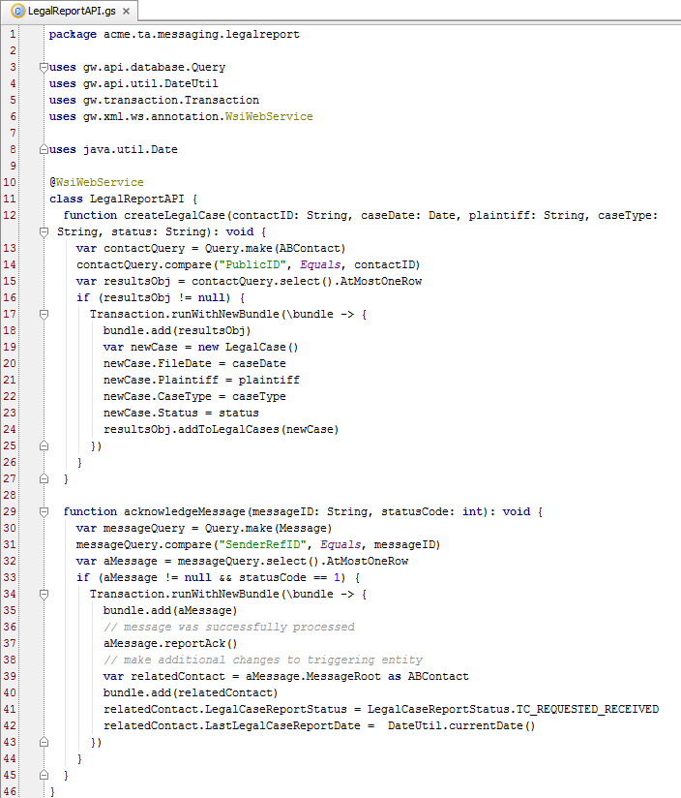

Using a custom web service
A custom web service can provide the ACK code
Provides the flexibility to execute whatever logic is needed
LegalReportAPI
Notes:
There is a base application API, MessageToolsAPI, that can also be used to acknowledge a given message. However, for a given message, the only thing you can do is acknowledge it. You cannot execute any associated data changes. Because custom web services provide the flexibility to execute any required logic, Guidewire recommends that acknowledgements should be received through a custom web service.
Publishing custom web services is covered in detail in the Publishing Guidewire Web Services lesson.

Slide 32
Overview of message acknowledgements
Working with acknowledgements
Synchronous acknowledgement
Asynchronous remote call acknowledgement
Reply plugin acknowledgement
Message administration

Slide 33
Reply plugin acknowledgement
Acknowledges message asynchronously through a listener queue
external system
xx_message
sending message
Transport Plugin
asynchronous reply via listener or polling
Reply Plugin
Notes:
The reply plugin is an optional plugin that initializes a listener queue and associates it with the destination.
The reply plugin is implemented to receive replies as dictated by the external system, such as:
A listener to a JMS message queue
A socket listener
An RMI server

Slide 34
initTools() executed at application startup
1 package trainingapp.demo.messageack
2
3 uses gw.plugin.messaging.MessageReply
4 uses gw.plugin.messaging.MessageFinder
5 uses gw.plugin.PluginCallbackHandler
6
7 class SampleReplyPlugin implements MessageReply {
8 override function initTools(aHandler: PluginCallbackHandler, aFinder: MessageFinder) {
9 var _finder = aFinder
10 var _handler = aHandler
11 } …28 }
Executed during startup
Helpful in processing replies
Finds message with MessageFinder
Provides transaction context with Plugin
Notes:
initTools() is method specified in the reply plugin that is executed during server startup. It provides resources that may be useful in processing replies. Like both the request and transport plugins, a reply plugin also includes the same set of lifecycle methods including resume(), shutdown(), and suspend(). Reply plugins also have a setDestinationID() method.

Slide 35
Message reply plugin tools
MessageFinder finds the message to be acknowledged based on:
The message identifier (typically SenderRefID and destination ID)
The message integer ID if SenderRefID is not used
PluginCallbackHandler provides transaction context for:
Acknowledging the message
Any additional entity data changes
If multiple replies are received for the same message, the reply plugin implementation should not change system state or cause harm

Slide 36
Message reply plugin: Example
Implementation skeleton for an imagined communication protocol
public class ExtSysReplyPlugin implements MessageReply, MyAsync {
// called by asynch reply delivery over the communication protocol
public void onAsynchronousReply(Reply reply) throws Throwable {
_handler
.execute(new PluginCallbackHandler.Block() {
public void run() {
Message msg = _finder
.findBySenderRefID(reply.getCorrelationID(), _destID);
if (reply.isOK()) {// if reply OK
msg.reportAck(); }
}
});
}
//…
public void initTools(MessageFinder finder, PluginCallbackHandler handler) {_finder = finder; _handler = handler; }
public void setDestinationID(int id) {_destID = id}
public void setParameters(Map param) {…}
public void resume() {// setup asynch reply delivery over communication protocol… }
public void suspend() {…}
public void shutdown() {…}
}

Slide 37
Deploy message acknowlegement code
Restart
Destinations
Plugin registry elements
Reply Plugin Gosu class
Destination
Plugin Registry
Reply Plugin Gosu Class
Notes:
You must restart the server when you create or modify destinations, plugin registry elements, and/or reply plugins.
If you implement your message reply plugin in Java, then you will need to compile the Java class and recopy it into the Guidewire directory structure.

Slide 38
Overview of message acknowledgements
Working with acknowledgements
Synchronous acknowledgement
Asynchronous remote call acknowledgement
Reply plugin acknowledgement
Message administration

Slide 39
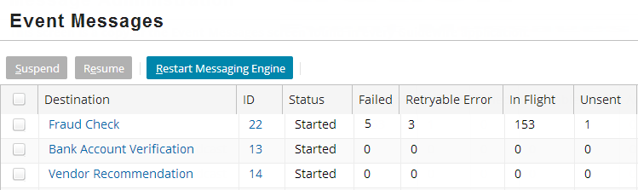
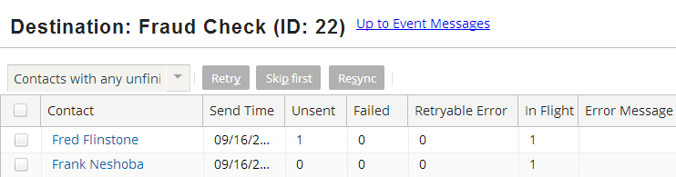
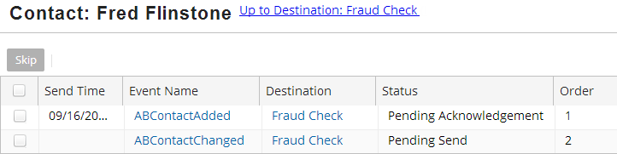
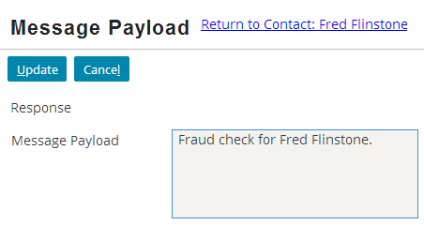
Message administration
A series of drilldown screens for message administration
Administration tab → Event Messages
Notes:
The Event Messages screens group all unacknowledged messages by:
Destination, then...
Primary entity (safe-ordering, plus one set for all unordered), then...
Status: failed, retryable error, in flight, and unsent

Slide 40
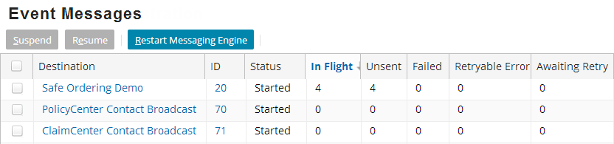
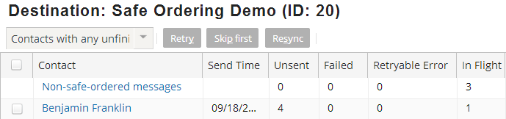
Event Message
Suspend, resume, and view messages for each destination
Safe-ordered and non-safe-ordered messages
When applicable, screen segments messages
Notes:
From Event Messages, you can suspend, resume, and view messages for each destination
When safe ordering applies to a destination, the screen separates messages into safe-ordered and non-safe ordered
The following lists the primary safe ordering entity and resync event name for each application:
ClaimCenter: Claim; ClaimResync
PolicyCenter: Account; ResyncAccount
ContactCenter: ABContact; ABContactResync
BillingCenter does not use safe ordering.

Slide 41
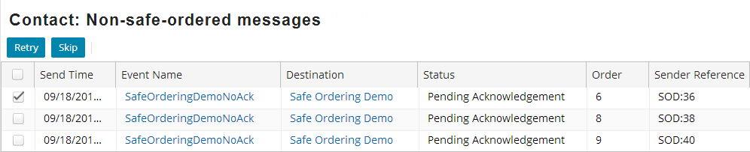
Drilldown screens
Retire or skip messages
Drilldown into message event
Edit the payload manually
Notes:
Each message can be retried or skipped as needed. You can also click the message's event name to view and manually edit the payload. Using the Destination screen, you can initiate a resync, which:
Skips ALL ordered messages (failed, retryable, in-flight, and unsent) on primary entity / destination pair
Raises an entity resync event, which is handled by Event Fired rules. The rules typically send similar message(s) to bring the external system back in sync with the Guidewire application.

Slide 42
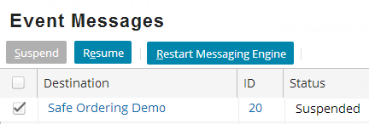
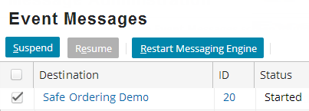
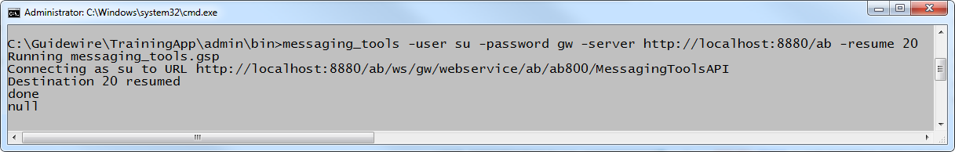
Message admin using MessagingToolsAPI
messaging_tools
-user user -password password -command -param
Syntax to execute from admin/bin
Commands include
[ -suspend | -resume ] destinationID
[ -retry | -skip ] messageID
Notes:
The specified user must have SOAP administration permissions. The list below specifies parameters relevant to messaging administration. The API also has additional non-messaging capabilities. For further information on messaging_tools, refer to the System Administration Guide.
Option Description
-user user Specifies the user to run the process.
-password password Specifies the administrative password.
-server url Specifies the host server url.
-resume destinationID Resumes the operation of the specified message destination.
-retry messageID Attempts to resend a message that failed. The message must be a candidate for retrying.
A message is a candidate if the error at the destination system was temporary and the message destination has no automatic retry mechanism.
-retrydest destinationID Retries all retryable messages for a message destination.
(continued...)

Slide 43
Notes:
-skip messageid Skips a message with the specified ID. If you mark a message as skipped, then Guidewire stops trying to resend the message. After you skip a message, you
can not retry it.
-statistics destinationID Prints the statistics for the specified destination.
-suspend destinationID Suspends a message destination.
Use this command if the destination system is going to be shut down or to halt sending while Guidewire
processes a daily batch file.
-purge date Deletes completed messages that are older than a specified date. (See "Purge Tool" below.)
Purge Tool
The purge tool deletes messages in Acked, ErrorCleared, Skipped or ErrorRetried state with send time before the specified date. If the purge tool succeeds in removing these messages without error, it reports “Message table purged”. Since the number and size of messages can be very large, periodically use this command to purge old messages to avoid the database from growing unnecessarily.

Slide 44
Describe the different types of acknowledgements
Acknowledge messages as successful, retryable errors, and non-retryable errors
Acknowledge messages synchronously
Acknowledge messages asynchronously
Use the administration screens to view a message's status and manipulate it manually as needed

Slide 45
What are the four possible ways Guidewire can interpret an external system's response to a message?
Under what three circumstances is an entry added to the MessageHistory table?
Under what circumstances are acknowledgements processed:
By the transport plugin?
By the reply plugin?
Without involvement from any plugin?
When should you use each of the following methods?
aMessage.reportError(retryTime)?
aMessage.reportError(errorCode)?
Notes:
Answers
1. Positive acknowledgement, retryable error, non-retryable error, duplicate. (There could also be no response to a message.)
2. The message is positively acknowledged, skipped, or retried. (For the first two, the message is removed entirely from the Message table. For the third, a copy of the original message remains in the Message table.)
3a) When the reply is received synchronously.
3b) When the reply is received asynchronously through a listener or polling
3c) When the reply is received asynchronously by an external system call to an API
4a) When the message needs to be retried and the message has not reached its maximum number of retries.
4b) When the message needs to be retried, but the message has reached its maximum number of retries.

